Slide 1
Introduction to the Youth PQA
Notes:
The agenda that appears on the next several pages is designed for those who have completed the PQA Basics live training and wish to share the PQA and Self Assessment process with their staff or colleagues. Typically, this means you have completed the training yourself and now you are going back to facilitate the self assessment process with your team.
We recommend you adopt three goals for this introduction to the PQA and self assessment:
After participating in this meeting, team members will:
understand the team-based, non-punitive nature of self assessment
have a working understanding of the PQA instrument and what it measures
grasp the importance of objective observations to drive scoring decisions
If you have ideas for ways to meet these goals that go beyond this agenda, we encourage you to use them!
We estimate that this agenda will take about an hour, maybe more, depending on the size of your group.
Preparation
Make sure you have all the materials listed below. Also, we recommend that you ask your staff to read the first 2 pages of the PQA handbook before the meeting.
Web access and a projector
Introduction to the Youth PQA Slides (download at cqitoolkit.org)
Copies of the following from the Handbook or www.cypq.org/takeitback: Introduction, Youth Program Quality Intervention, Implementation Plan
Copy of Youth PQA for each participant
Index Cards
Agenda Overview
Welcome (5 minutes)
Introduction to the Program Quality Assessment (PQA) (10 minutes)
PQA Sort (10-20 minutes)
Observation & Note Taking (10-20 minutes)
Planning for Data Collection & Scoring (10-20 minutes)
Closing Reflection (5 minutes)

Slide 2
Agenda
Welcome
Assess-Plan-Improve
PQA overview
Observation and Note Taking
Planning for Data Collection and Scoring
Notes:
Introduce yourself, welcome participants to the workshop and overview the agenda for today’s workshop.
Say, “This meeting will help you to understand the purpose of self assessment and your role in the process.” Review the goals.

Slide 3
Objectives
Team members will
understand the team based, non-punitive nature of self assessment.
have a working understanding of the PQA tool and what it measures.
grasp the importance of objective observations to drive scoring decisions.

Slide 4

Partnership
BGCA has partnered with the David P. Weikart Center for Program Quality to develop a CQI system specifically for Clubs, based on the Weikart Center’s evidence-based Youth Program Quality Intervention
The Introduction to the Youth PQA has been adapted with permission from the David P. Weikart Center for Youth Program Quality.
Notes:
Read the slide.

Slide 5
Researchers Agree:
on what it takes to support positive youth development.
The National Research Council & Institute for Medicine list the following key features of positive youth development settings:
Physical and psychological safety
Appropriate structure
Supportive relationships
Opportunities to belong
Positive social norms
Support for efficacy and mattering
Opportunities for skill-building
Integration of family, school and community efforts
- Community Programs to Promote Youth Development, 2002
Notes:
Say, “A 2002 report by the National Research Council reviewed the combined results of many research studies and synthesized those findings into this list of key features of programming that work best to support youth development. I’ll give you a minute to read the list.
{wait 1 minute}
There aren’t many surprises in here, but these are the things that research has shown will positively impact youth development….“

Slide 6
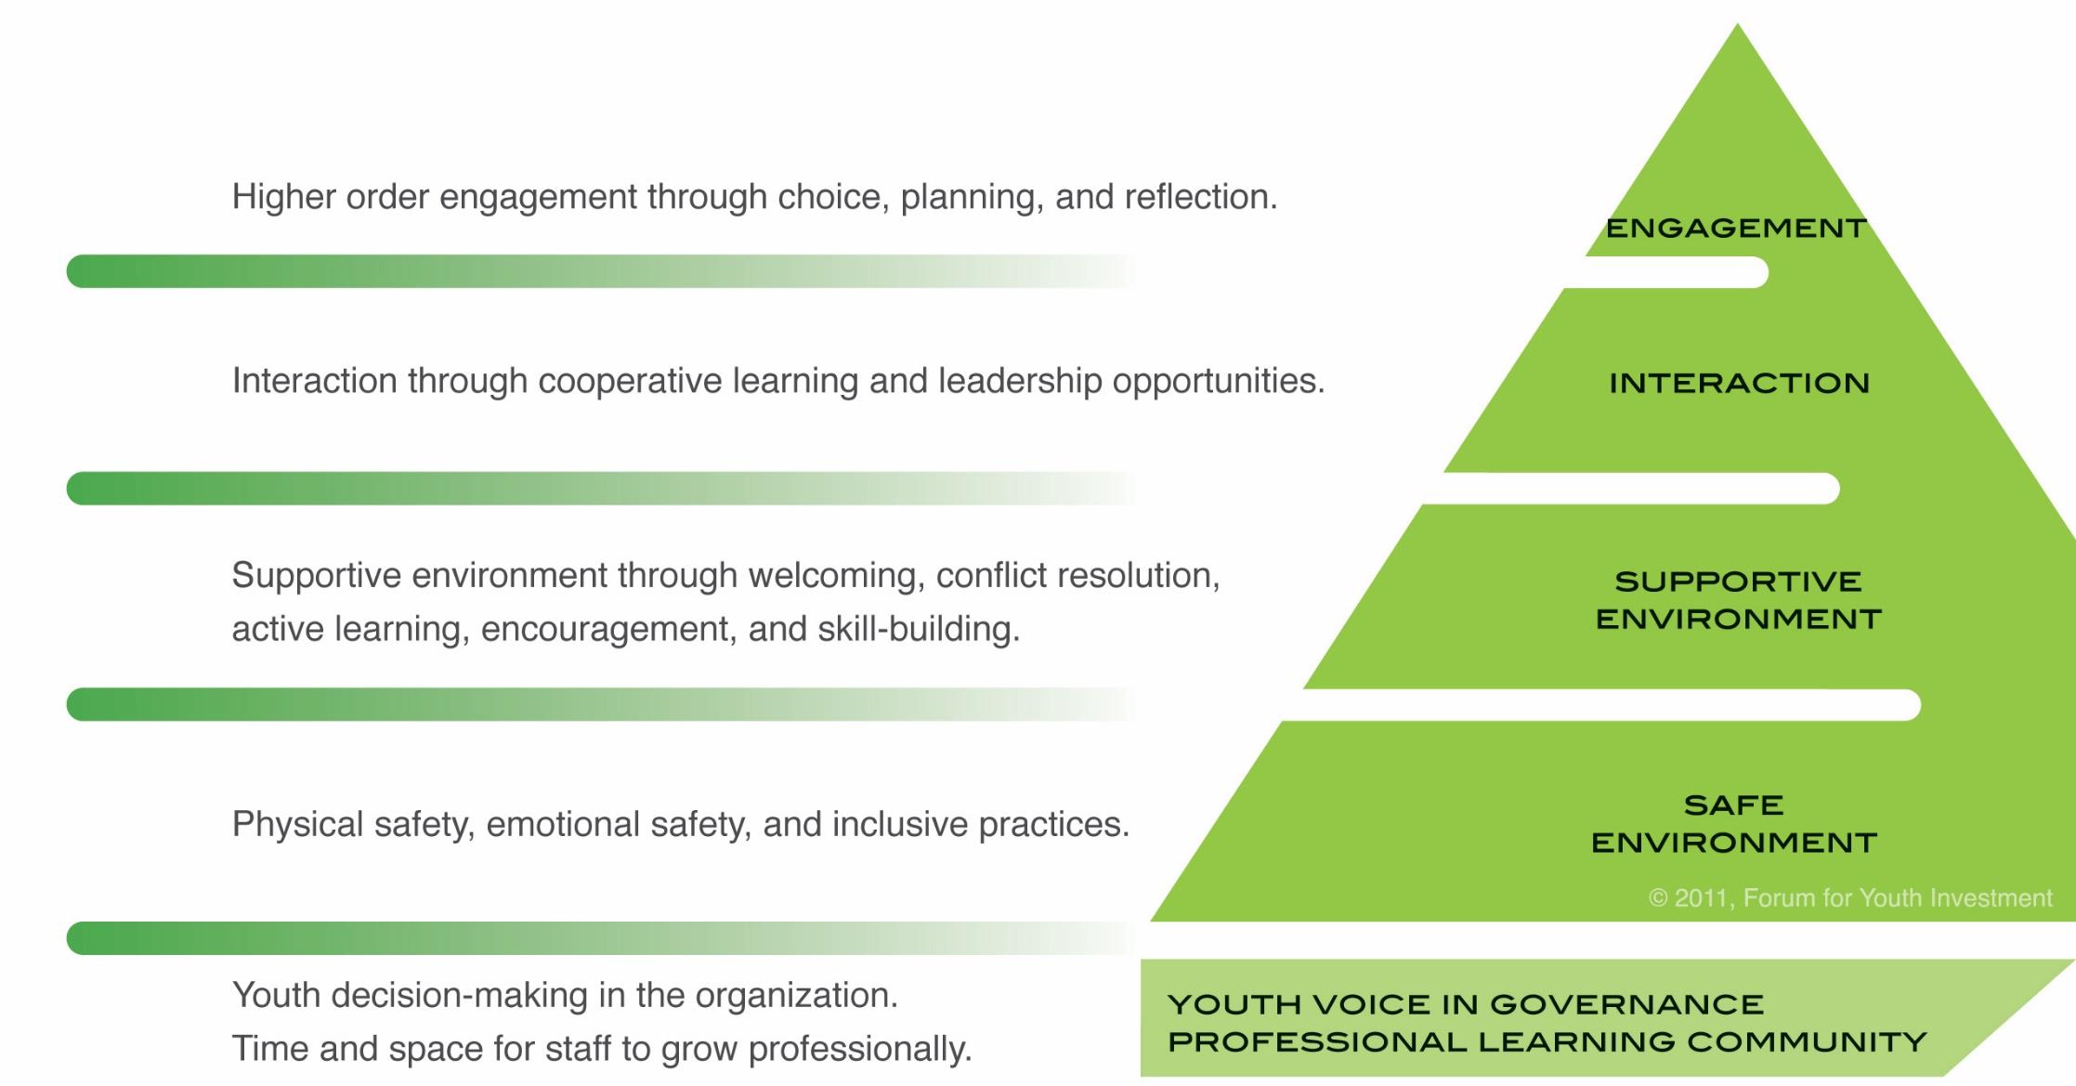
Weikart Center’s Pyramid of Program Quality
Notes:
Say, “… and this research is in support of what is measured in the Youth PQA.
The Youth PQA is designed to measure key developmental experiences within an afterschool setting.
It is based around Maslow’s hierarchy of needs, where the bottom of the pyramid needs to be in place before the top can be reached.
At the bottom of the Pyramid of Program Quality is safe environment. This includes both physical and emotional safety.
Above that we have a supportive environment, which is mostly provided by the staff – do they plan sessions so that they’re at the right pace for youth? Do youth have an opportunity to build skills, and are they encouraged to do so despite mistakes? Are adults providing support for learning?
Interaction looks at the relationships between youth and other youth and between the adults and youth.
Engagement is different than what we typically think of when we hear the word engagement. Youth being involved in an activity, listening, participating – those are all wonderful things, and they are measured in the interaction and supportive environment domains of the pyramid. In the Youth PQA, there are 3 things that define engagement: Youth having opportunities to Plan what they’re doing, make choices about what they’re doing, and Reflect on what they’re doing. They’re at the top of the pyramid because all of the other domains below it set the stage for these to happen.”

Slide 7
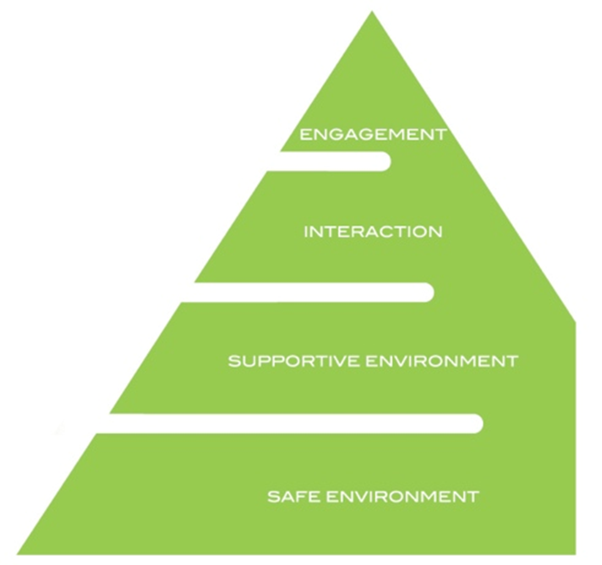
Quality Construct: Weikart Center’s Youth PQA?
A validated instrument designed to assess the quality of youth programs and identify staff training needs.
A set of items that measures youth access
to key developmental experiences.
A tool which produces scores that can be
used for comparison and assessment of
progress over time.
Notes:
Say, “The Youth PQA is a validated tool, which means that there was a huge research study that checked to make sure that it measures what we think it measures.
And what is measures is key developmental experiences – things adults and kids do that make a difference for youth.
The Youth PQA can also be used over time – you can score your program this fall and next spring and see if your practices have improved.”

Slide 8
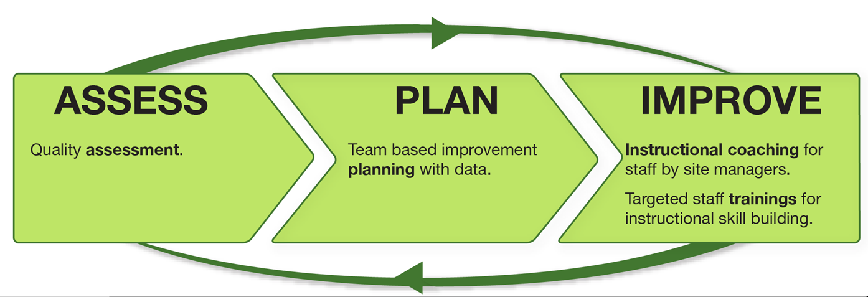
Youth Program Quality Intervention
Notes:
Say, “The PQA is just the first step in a larger cycle of improvement, which is called the Youth Program Quality Intervention. After you conduct your assessment, the next step is to develop a plan for improvement based on the data, and then to carry out that plan to improve the quality of your program for kids.
It’s important to remember that this process is all about program improvement. It’s not about evaluating staff or catching someone doing something wrong. It’s about taking an honest look at your program, talking about it with your team, and answering the question, ‘Are we providing the best possible experiences for our young people?’”

Slide 9
PQA Sorting Activity
Pick a number 3-20
Turn to that page in the PQA
Decide if the program is low, medium, or high quality based on the descriptor for each item
Provide supporting Evidence on why you rated each item the way you did.
Notes:
Facilitate Activity: If there are more than five people in the group, they can be divided into pairs or smaller groups, otherwise everyone can work together. Randomly select a number between 3 and 20. Turn to that page in the Youth PQA. Read each item and decide if the program is low, medium, or high quality. As we rate each item, one person should share an example or anecdote that supports the rating.”
Facilitate a reflection on the activity:
“How did it feel to self-assess in this way?”
“How did you know how to rate each item?”
“Were you surprised by any of the scores or did you disagree with any?”
“What were some of the limitations of this process?”

Slide 10
PQA Sample Item
“Domain”
“Form”
III. INTERACTION: BELONGING | COLLABORATION | LEADERSHIP | ADULT PARTNERS
BELONGING | Youth have opportunities to develop a sense of belonging.
ITEMS |  |  |  |  |  |  |  | SUPPORTING EVIDENCE
1 Youth have no opportunities to get to know each other (beyond self-selected pairs or small cliques). |  | 3 Youth have informal opportunities to get to know each other (e.g., youth engage in informal conversations before, during, or after session. |  | 5 Youth have structured opportunities to get to know each other (e.g., there are team-building activities, introductions, personal updates, welcomes of new group members, icebreakers, and a variety of groupings for activities)
 |  |  |  |  |  |  |  | The staff started the session by facilitating 2 icebreakers (all of my neighbors and 2 truths and a lie)
“scale”
“anecdotal evidence”
“item”
“level/ indicator/ descriptor”
Notes:
Say, “Here’s a sample item. The written evidence goes in the white space on the right, then the score goes in the box – 1, 3, or 5 (no 2s or 4s!).
This sample demonstrates how the tool addresses a common positive youth development topic. It’s generally agreed that youth do better when they feel a sense of belonging. This slide shows one item we use to get at that idea. Notice how this converts an inner state (whether youth feel like they belong) to a measurable behavior (whether staff provide get to know you activities).
Each booklet is a Form. To see how Form A breaks down, look at the last page (titled “Youth PQA Summary Sheet”). The boldface words are the Domains and the words at the top of each page are Scales. A scale is usually a single page. A scale contains 2 to 6 items like the one on this slide. To determine the score, you rely on the level or item descriptor that best fits your anecdotal evidence.“

Slide 11
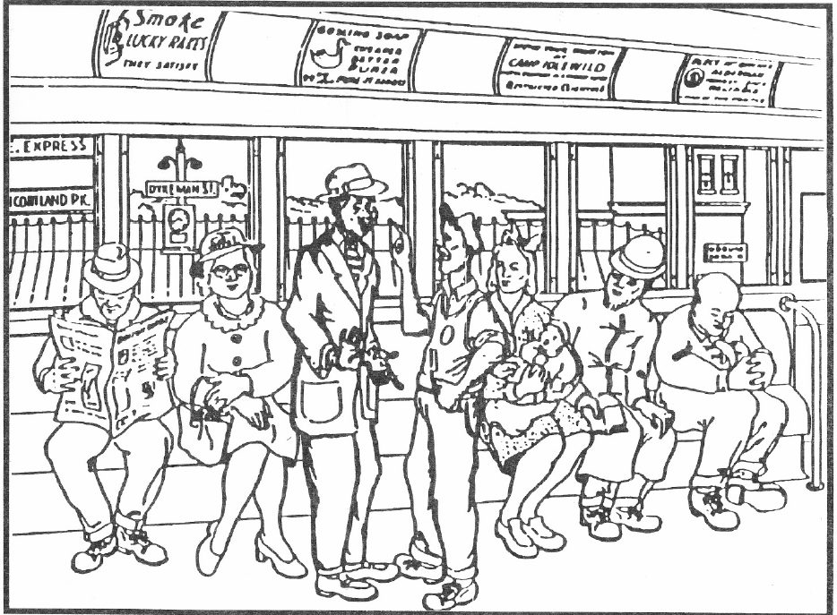
Notes:
Show “People on the train slide”. Ask, What do you see here? Guide participants to the concept of subjective and objective observation.
Divide large group into three smaller groups (you may have people working individually or going up more than once.) Assign one group a freeze-frame scene, one a silent picture, and one a “talkie.”
Give each group two minutes to plan their skit, then 30 seconds to present. Instruct observers to take notes while their peers present.
Debrief. What did the audience get right? What did they miss? What does this mean for how we observe?

Slide 12
Note Taking
MORE EFFECTIVE NOTES
Are factual and objective
Offer rich detail in snapshot form
Focus on the interactions
Contain quotes
Can stand alone
  someone who was not there should be able to read the notes and know what happened
LESS EFFECTIVE NOTES
Use subjective terms such as good or bad
State opinions
Make assumptions
Are too vague, lack detail
Summarize discussions instead of using quotes
Notes:
Explain effective and ineffective notes.
Discuss the principles and logistics of observing and taking notes

Slide 13
Planning for Data Collection and Scoring
How many observations will we conduct?
Which offerings will we observe?
Who will observe whom?
What day and what time?
What coverage is needed?
When will our scoring meeting be? (Remember to budget 3 hours)
Any other concerns?
Notes:
As a group, determine the logistics for data collection and agree upon dates. Use the questions provided as a guide.
Refer to your Handbook for more information.

Slide 14
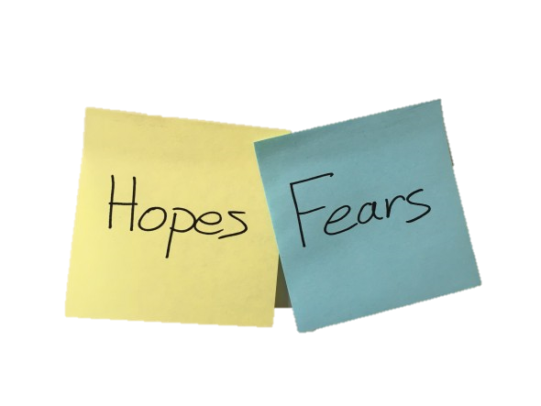
Reflection
Fear: something you are nervous about or afraid of as you move into the team self assessment.
Hope: something you hope to gain as the team self-assessment
Notes:
Facilitate a reflection. Distribute 3x5 cards to each participant. Instruct everyone to write one Hope that they have for the self assessment process, and on the other side, one Fear that they have. Have volunteers share, start with fears first, then move to hopes.

